Slide 1

Credit EDA Case Study
By Audumbar Awate

Slide 2

Agenda
In this Presentation we will see what this credit case study is about, and why it's important to analyze credit risk
The primary goal of this study is to assess the creditworthiness of loan applicants using data analysis techniques. We'll also explore how credit risk can be managed effectively.
Credit risk analysis will help the company to make a decision for loan approval based on the applicant's profile. Which controls loss of business to the company and avoid financial loss for the company.

Slide 3

Business Understanding
The loan providing companies find it hard to give loans to the people due to their insufficient or non-existent credit history.
When the company receives a loan application, the company has to decide for loan approval based on the applicant’s profile.
If the applicant is likely to repay the loan, then not approving the loan results in a loss of business to the company
If the applicant is not likely to repay the loan, i.e., he/she is likely to default, then approving the loan may lead to a financial loss for the company.

Slide 4

Data Understanding
This dataset has 3 files as explained below:
'application_data.csv' contains all the information of the client at the time of application. The data is about whether a client has payment difficulties.
'previous_application.csv' contains information about the client’s previous loan data. It contains the data whether the previous application had been Approved, Cancelled, Refused or Unused offer.
'columns_description.csv' is data dictionary which describes the meaning of the variables.

Slide 5
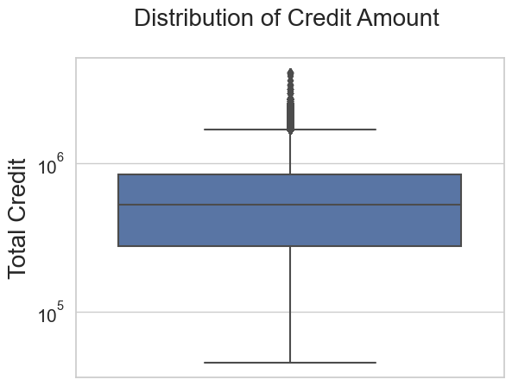
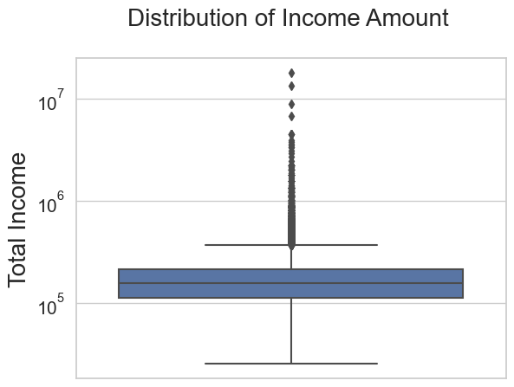
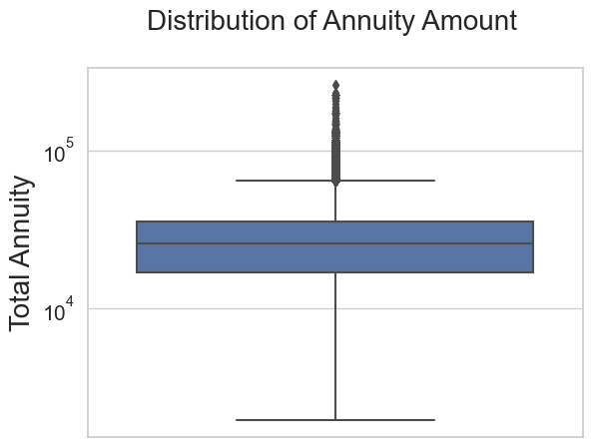
Finding outliers
1. The first quartile is bigger than the third quartile, that means most of the client credit lies in the first quartile.
2. There seems some outliers in the Credit boxplot
1. There seems to be an equal distribution of the Income amount of the clients.
2. Also some of the outliers present in the dataset.
1. The first quartile is bigger than the third quartile.
2. There seems some outliers in the Annuity boxplot

Slide 6
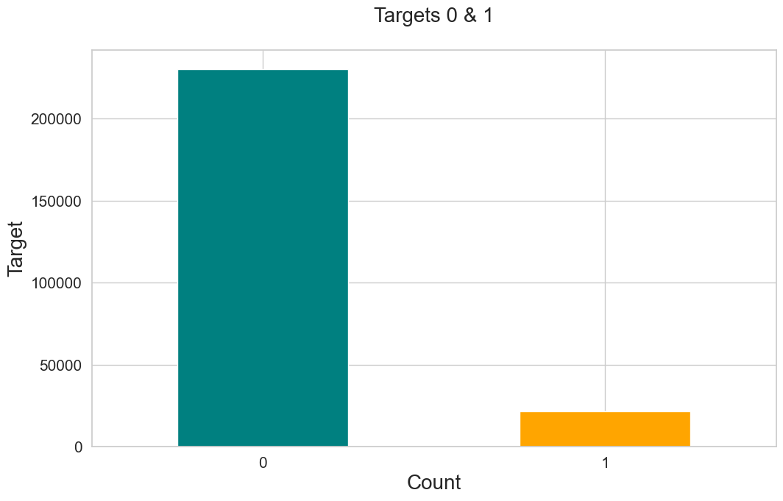
Imbalance Ratio
Here, Target = 0 means the people those who are non-defaulters
and Target = 1 means the people those who are defaulters.

Slide 7

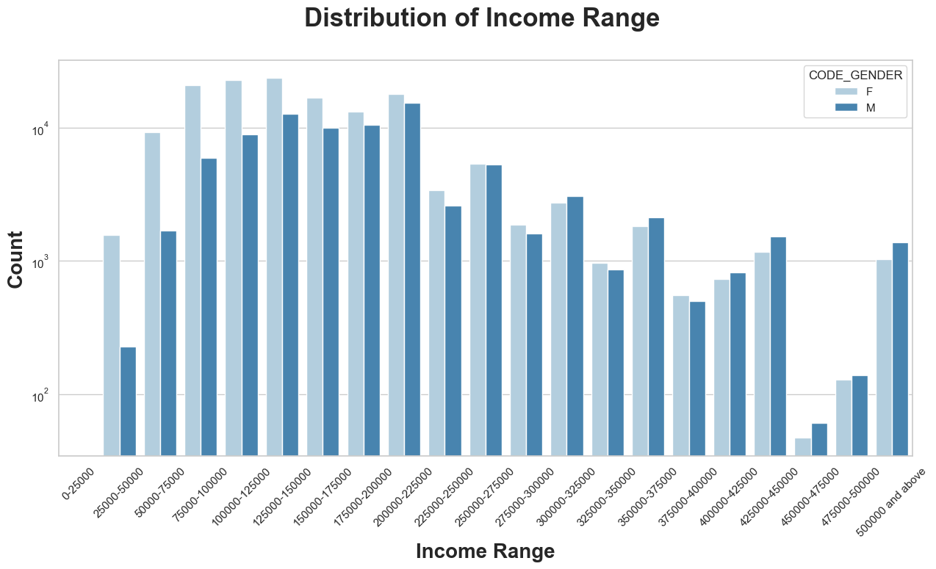
Univariate Analysis
Plotting a bar chart for those having no difficulties in re-paying the loan i.e the Target = 0 people
Count represents the number of people in Target = 0
Notes:
1. Income range from 125000 to 150000 is having more number of credits.
2. Very less count from range 450000-475000
3. It seems that the females are more than male in having credit for range: 125000 to 150000.

Slide 8
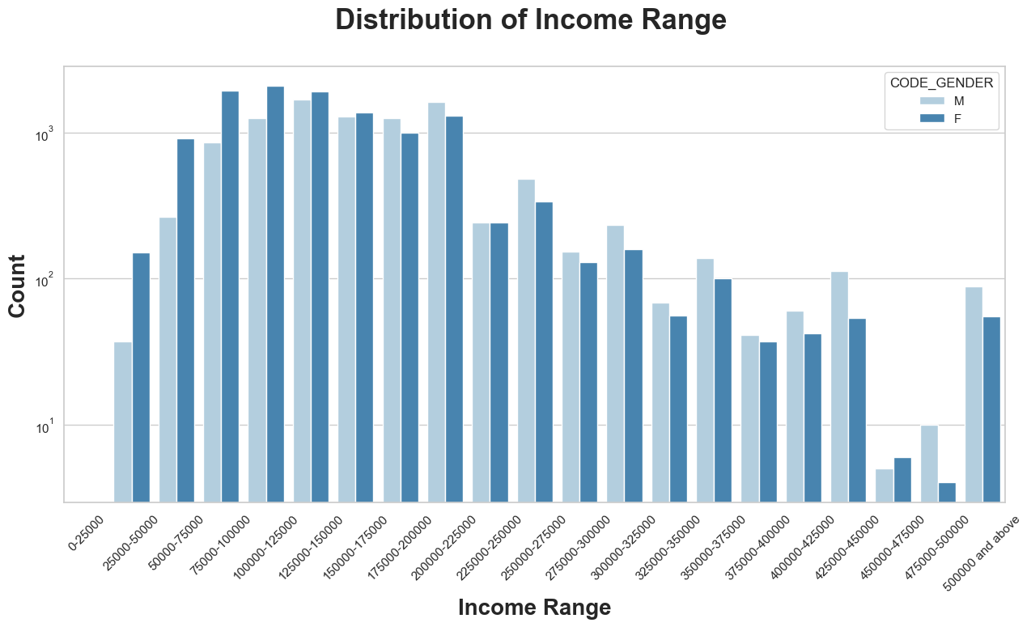
Univariate Analysis
Plotting a bar chart for those having difficulties in re-paying the loan i.e the Target = 1 people
Count represents the number of people in Target = 1
Notes:
1. Male Counts are higher.
2. Income range from 100000 to 200000 is having more number of credits.
3. Less count for income range 450000-475000.

Slide 9
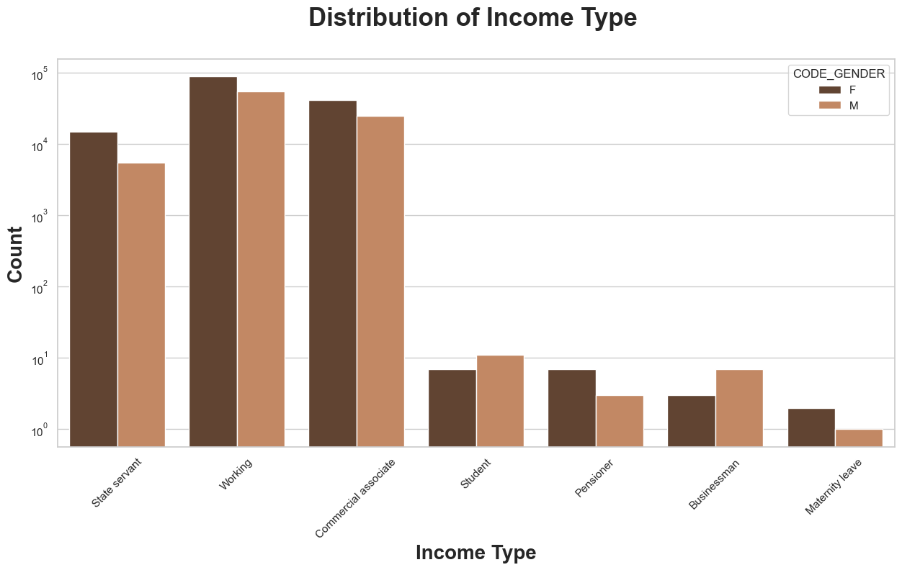
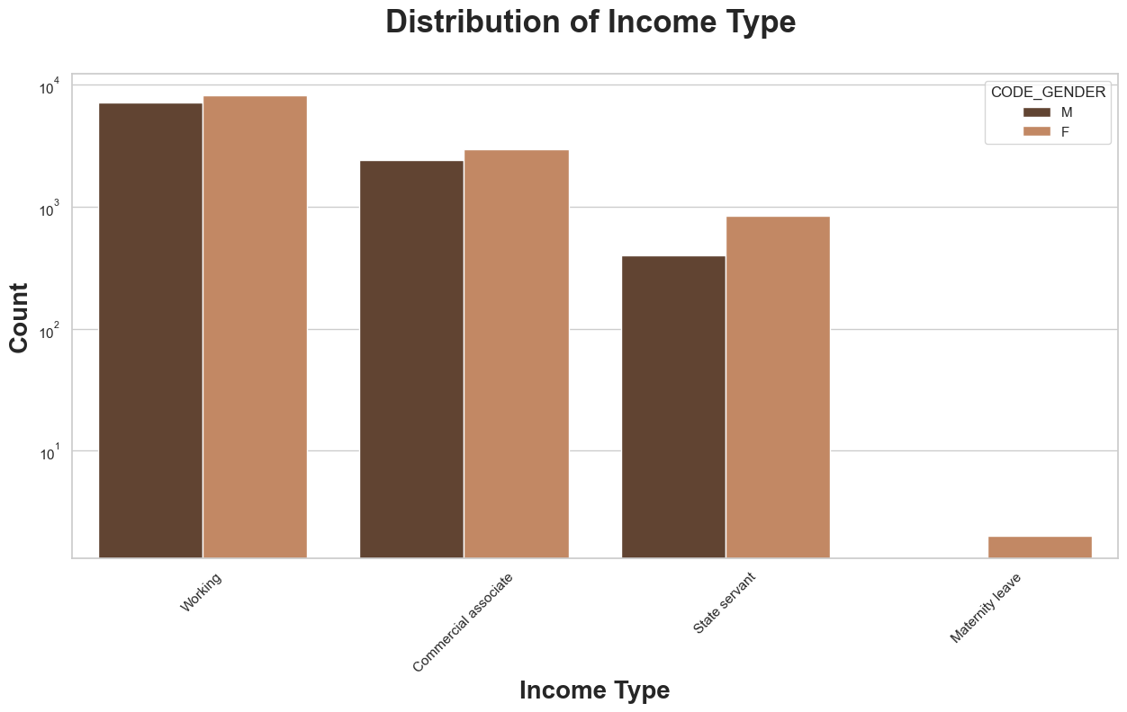
Analysis of Income Types Across Genders
The bar chart suggests that among individuals with target values of 0 and 1, working females have the highest credit score compared to other groups
Notes:
1. It seems that working women have most credit than others.
2. It seems that "State Servant, Working and Commercial Associate have more credit counts compared to others
3. It seems Women in "Maternity leave has less credit in comparison to others

Slide 10
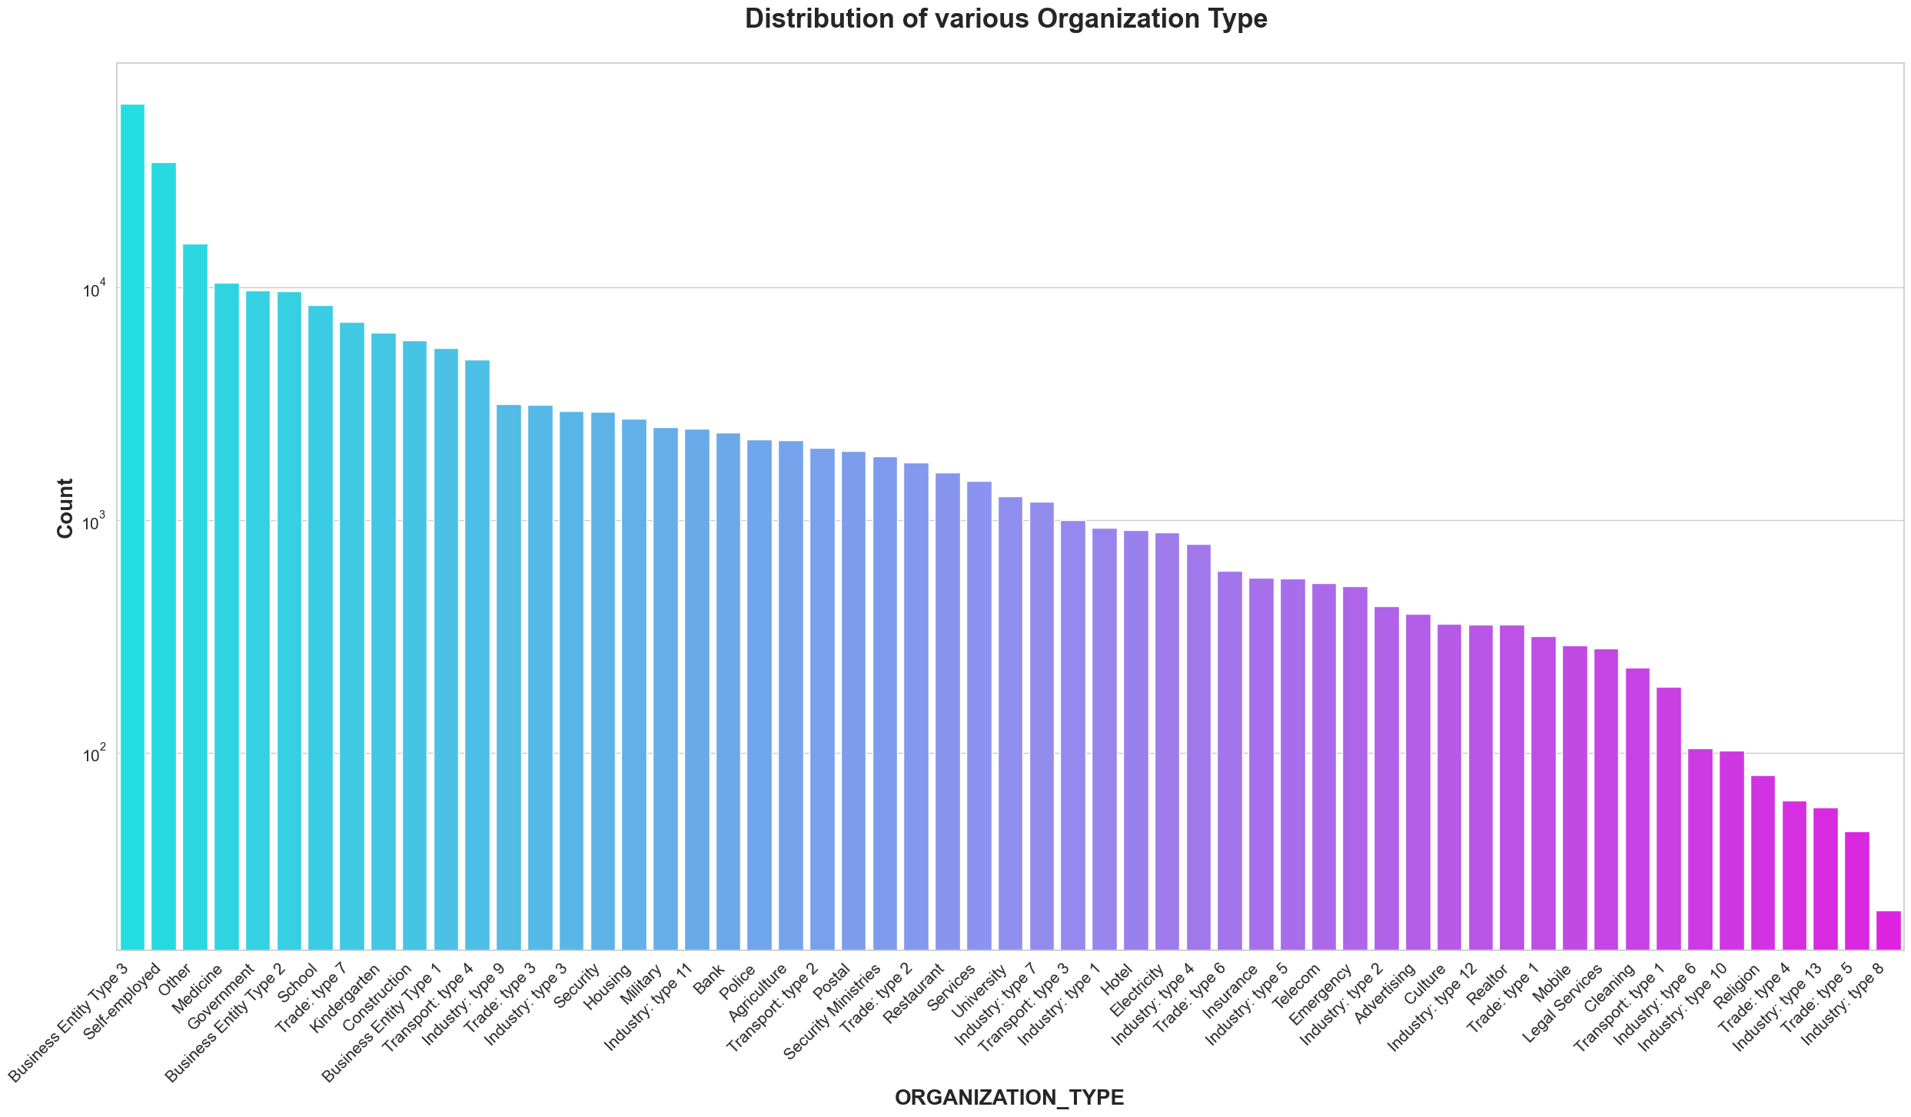
Analysis of Organization types
Clients which have applied for credits are from most of the organization type "Business entity Type 3', 'Self employed’, 'Other’, ‘Medicine’ and 'Government‘
2. Less clients are from industry type 8, type 6, type 10, religion and trade type 5, type 4.
Notes:
For Target = 0 more than 1L people works in Business entity Type 3, Self employed and othes

Slide 11
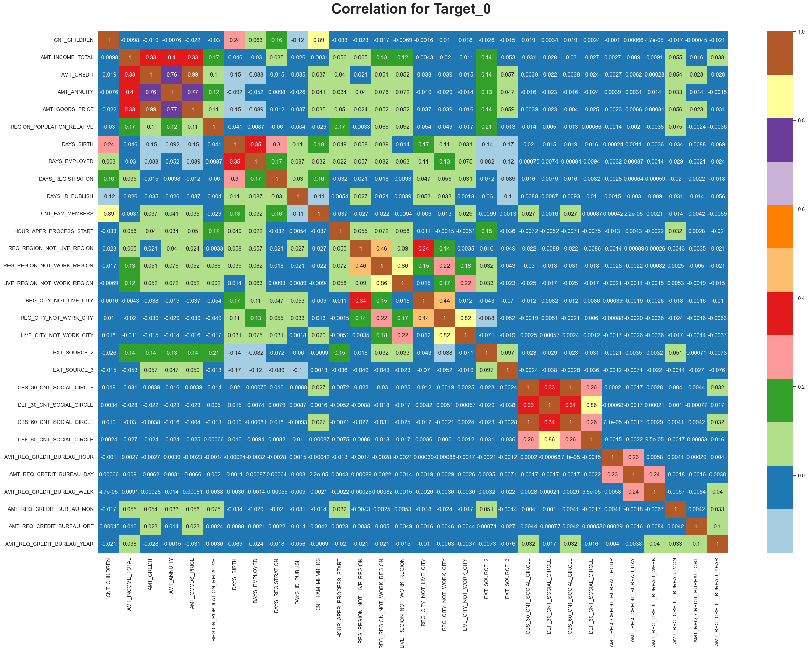
Correlations
Credit amount is inversely proportional to the date of birth, which means Credit amount is higher for low age
Income amount is inversely proportional to the number of children client have, means more income for less children client have
Credit amount is higher to densely populated area.
Notes:
1. Younger individuals may have a shorter credit history, leading to less data for lenders to assess their creditworthiness. This lack of information could make them less risky in the eyes of lenders
2. Having children can significantly impact a person's career and earning potential. Parents may need to take time off work for childcare, reduce their work hours, or choose less demanding jobs, which can limit their income growth
3. Densely populated areas often have higher levels of economic activity, with more businesses, industries, and job opportunities. This can lead to higher incomes and greater spending power, making individuals in these areas more attractive to lenders.
4. The income is also higher in densely populated area

Slide 12
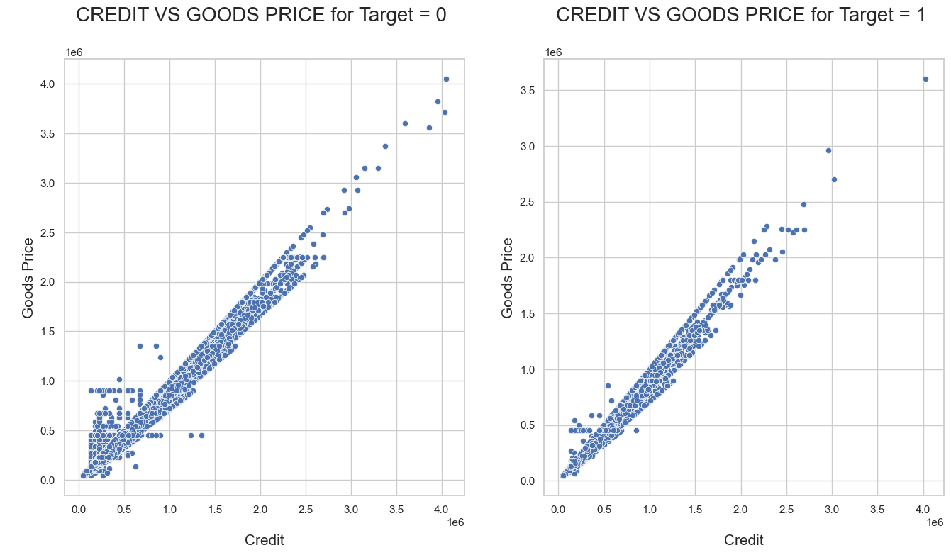
Bivariate Analysis of the numerical columns
With the scatter plot, we can determine that AMT CREDIT and AMT GOODS PRICE are highly correlated which means if increase in goods price, the credit increased directly and vice versa

Slide 13
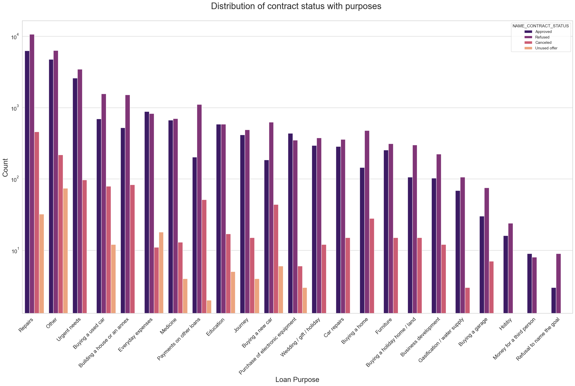
Performing the Univariate analysis
Most rejection of loans came from purpose 'Repairs'.
2. For education purposes we have equal number of approves and rejection.
3. Paying other loans and buying a new car is having significant higher rejection than approves.

Slide 14
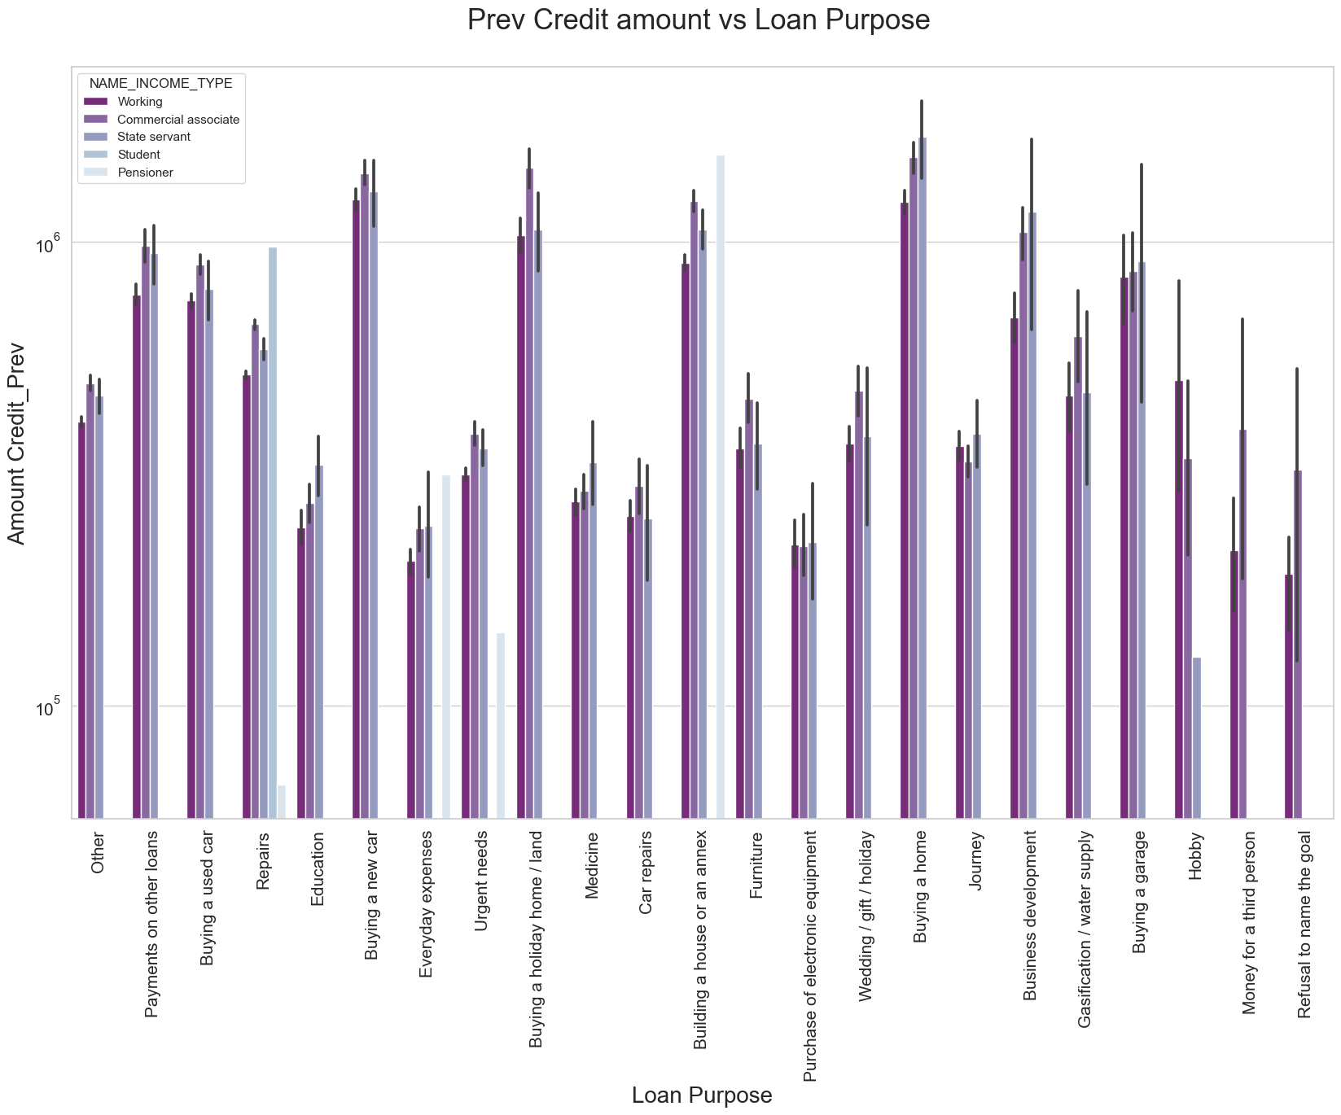
Performed the Bivariate Analysis
1. The credit amount of Loan purposes like 'Buying a home', 'Buying a land', 'Buying a new car' and 'Building a house' is higher.
2. Income type of state servants have a significant amount of credit applied.
3. Money for third person or a Hobby is having less credits applied for.

Slide 15
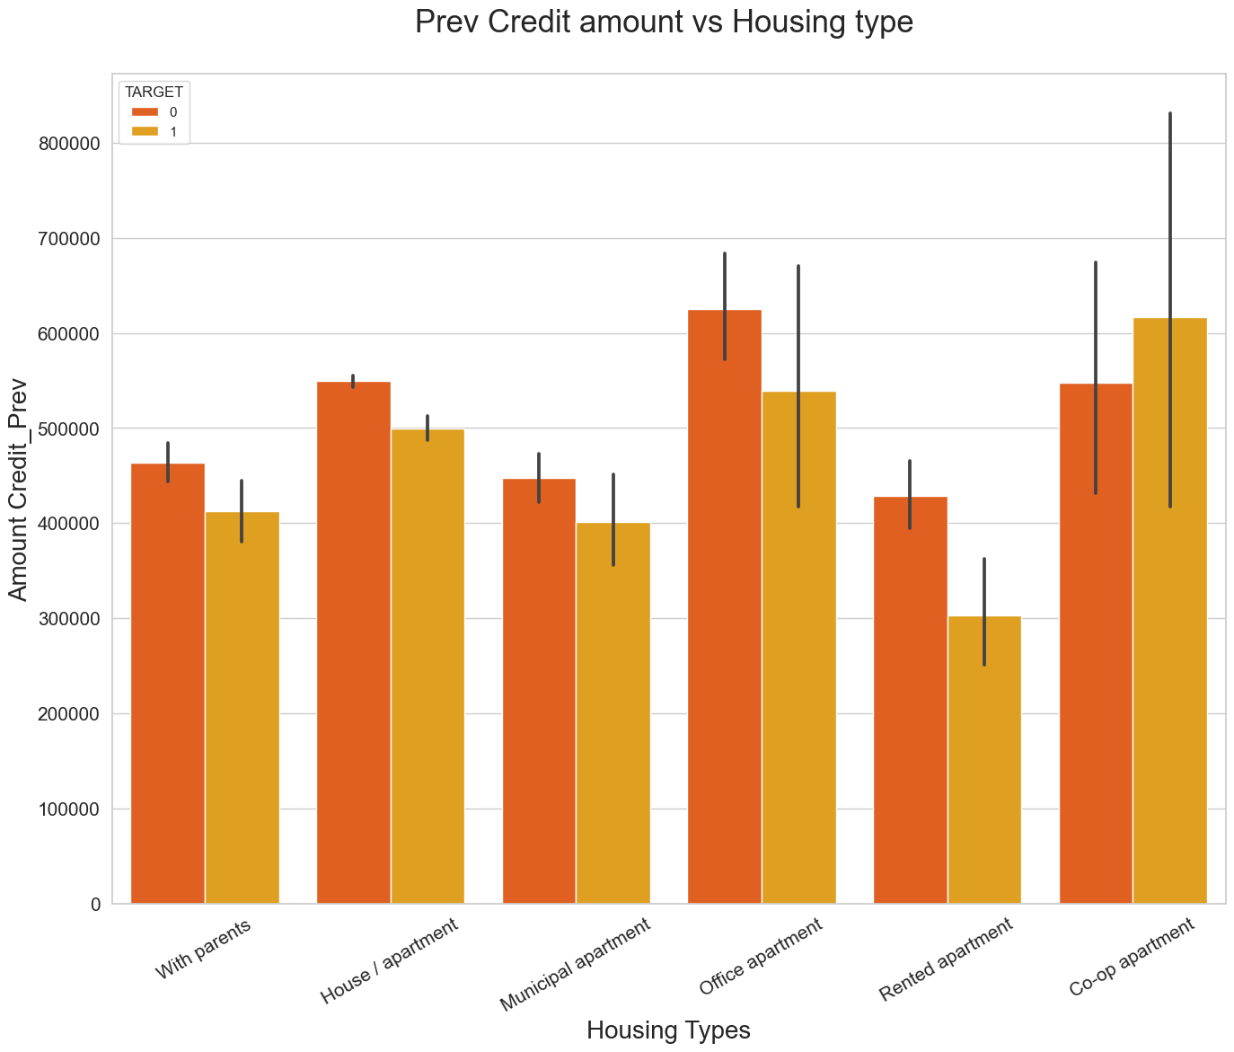
Credit_amount_prev vs Housing type
Here for Housing type, office apartment is having higher credit of target 0 and co-op apartment is having higher credit of target=1.
So, we can conclude that bank should avoid giving loans to the housing type of co-op apartment as they are having difficulties in payment. Bank can focus mostly on housing type with parents or House\ apartment or municipal apartment for successful payments.

Slide 16
Observation of this loan data analysis:
Banks should approve loans more for Office apartment, Housing / apartment type as there are less payment difficulties.
Banks should provide loans to ‘Repairs’ & ‘Others’ purposes.
Banks should focus more on contract type 'Student', 'Pensioner' and 'Businessman' with housing type other than 'Co-op apartment' for successful payments.
Working people especially female employers are the best to target for the loans.
The clients who had gotten previous approval have less payment difficulties so they are better candidates for approval of loan.
Clients whose application was cancelled are more risk to default.

